Slide 1
Application of CRISPR/Cas Systems as Antiviral Therapy
Helen Baddeley
Thursday 10th March 2022
Tutorial for Waynflete Studies Programme

Slide 2
WHY
Threat of viruses: emerging, chronic and latent
Vaccines – viral surface proteins rapidly mutate
Cure for latent infections

Slide 3
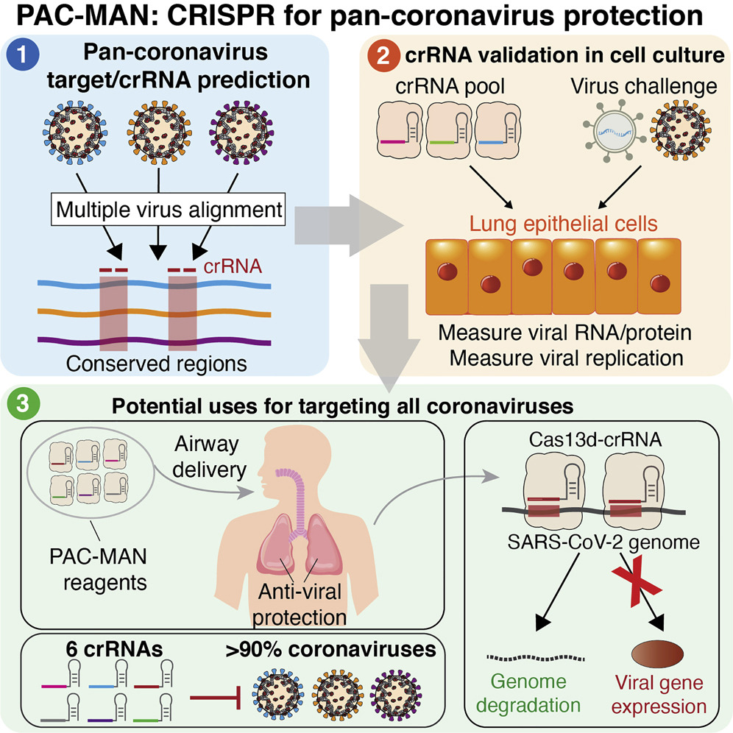
WHY
Abbott et al, Cell, 2020

Slide 4
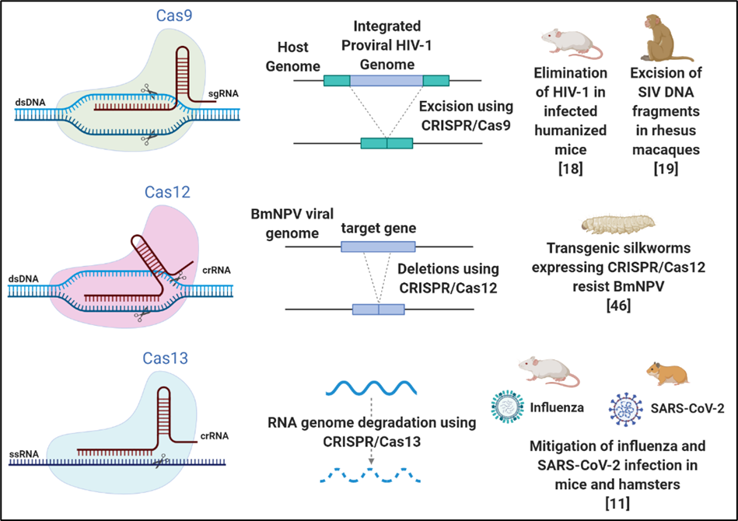
Class ii CRISPR/cas Systems

Slide 5
Class ii CRISPR/cas Systems

Slide 6
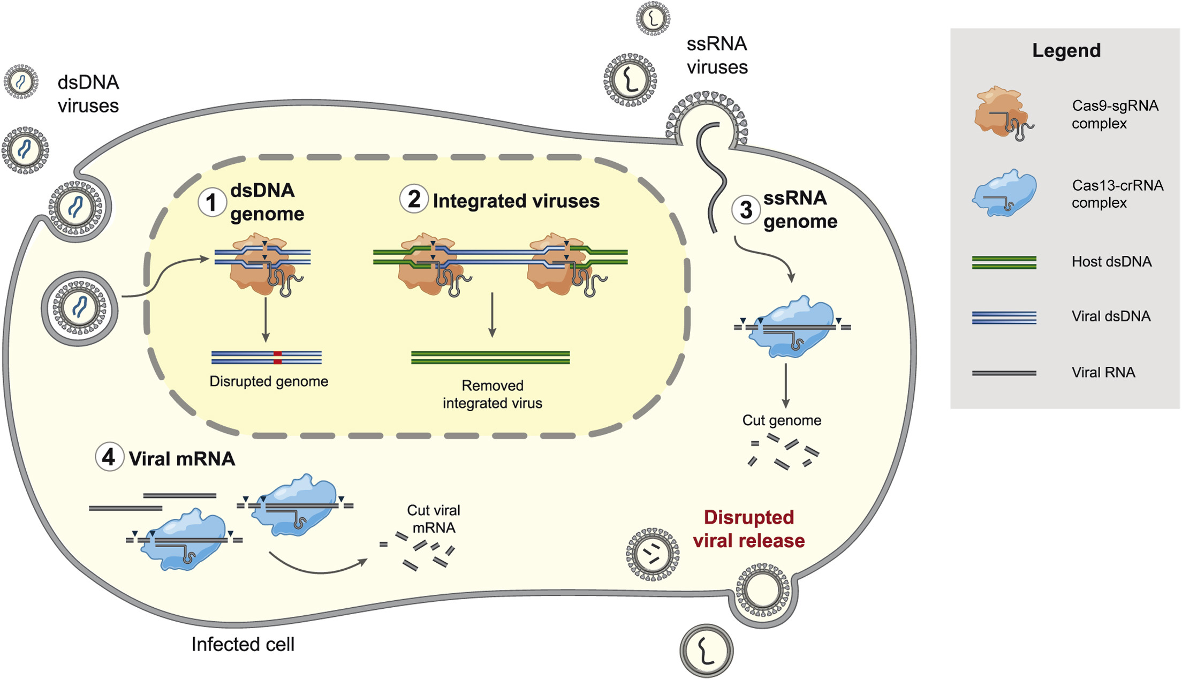
overview
Acute antiviral therapy – RNA viruses
Latent antiviral therapy – HIV
Chronic antiviral therapy – Hepatitis B Virus
Antiviral therapy for animals of economic interest
Freije & Sabeti, Cell Host & Microbe, 2021

Slide 7
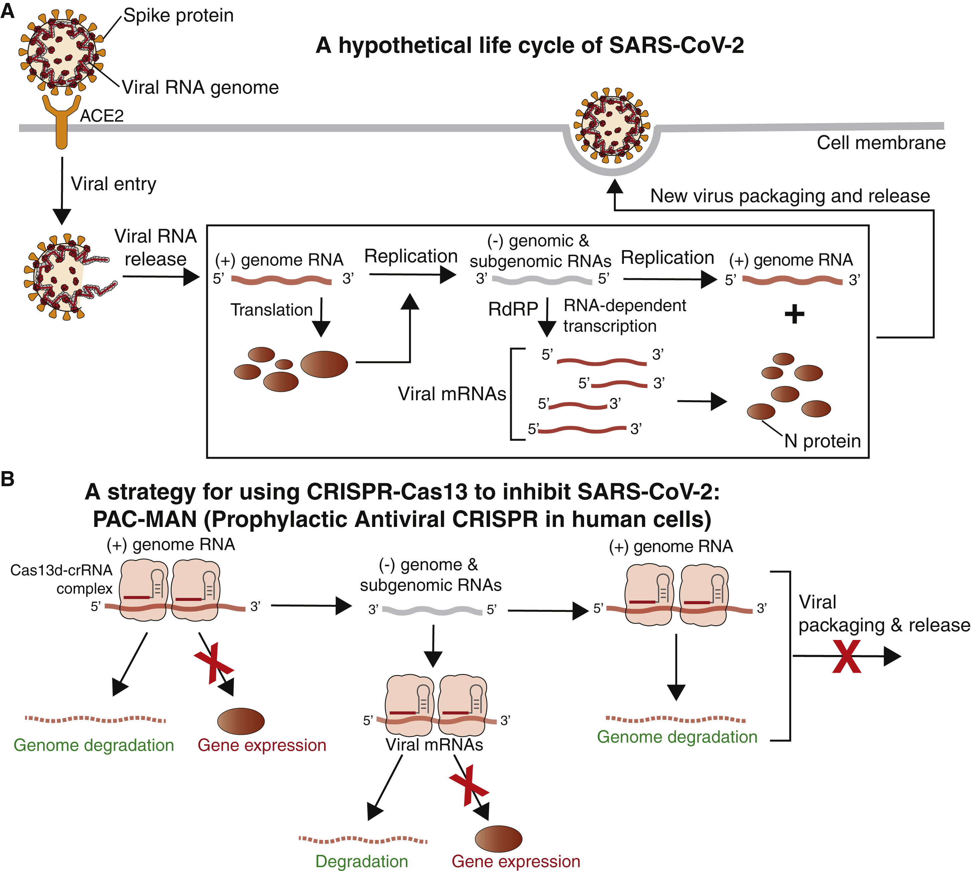
Cas13 Against SARS-CoV-2
Abbott et al, Cell, 2020

Slide 8
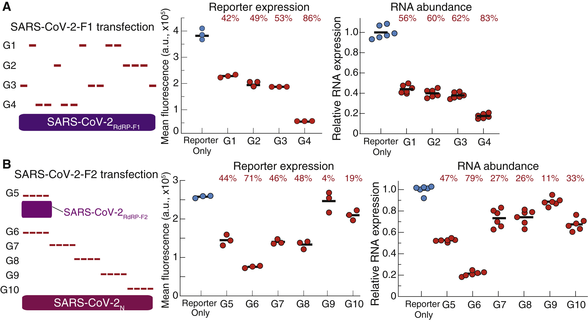
Pools of CRISPR RNAs (crRNAs) against:
RNA-dependent RNA polymerase (RdRP)
Nucleocapsid (N)
Abbott et al, Cell, 2020

Slide 9
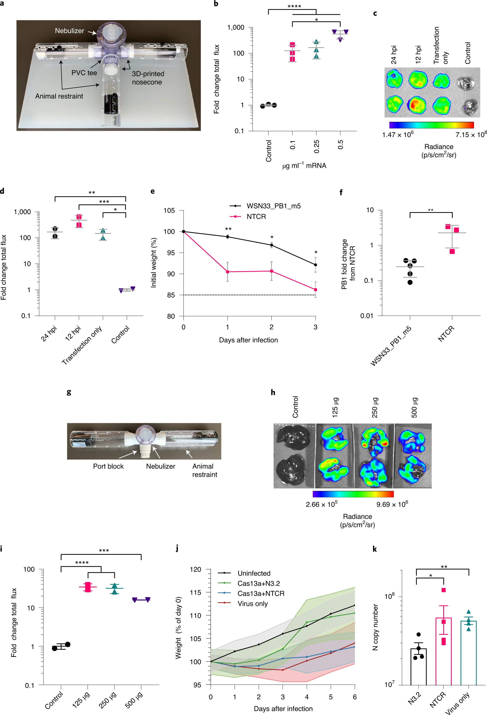
Cas13 Against SARS-CoV-2 in vivo
Clinical isolate
mRNA-encoded Cas13 delivered using a nebulizer
Prevention of weight loss
N3.2 = nucleocapsid
NTCR = non-targeting crRNA
Blanchard et al, Nature Biotechnology, 2021

Slide 10
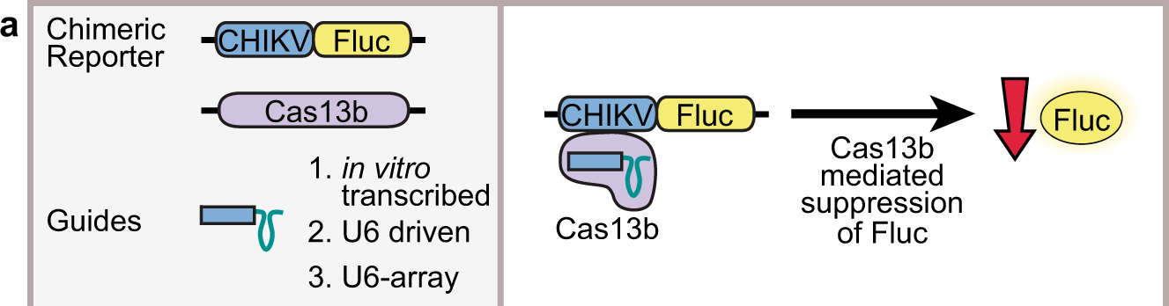
Cas13 Knockdown Of Viral Sequences In Mosquito Cells
CHIKV: chikungunya virus
Fluc: firefly luciferase
Tng et al, Communications Biology (Nature), 2020

Slide 11
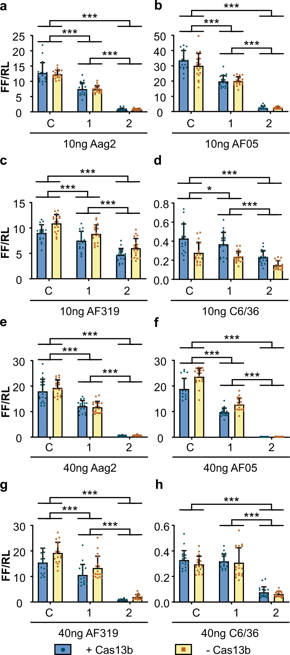
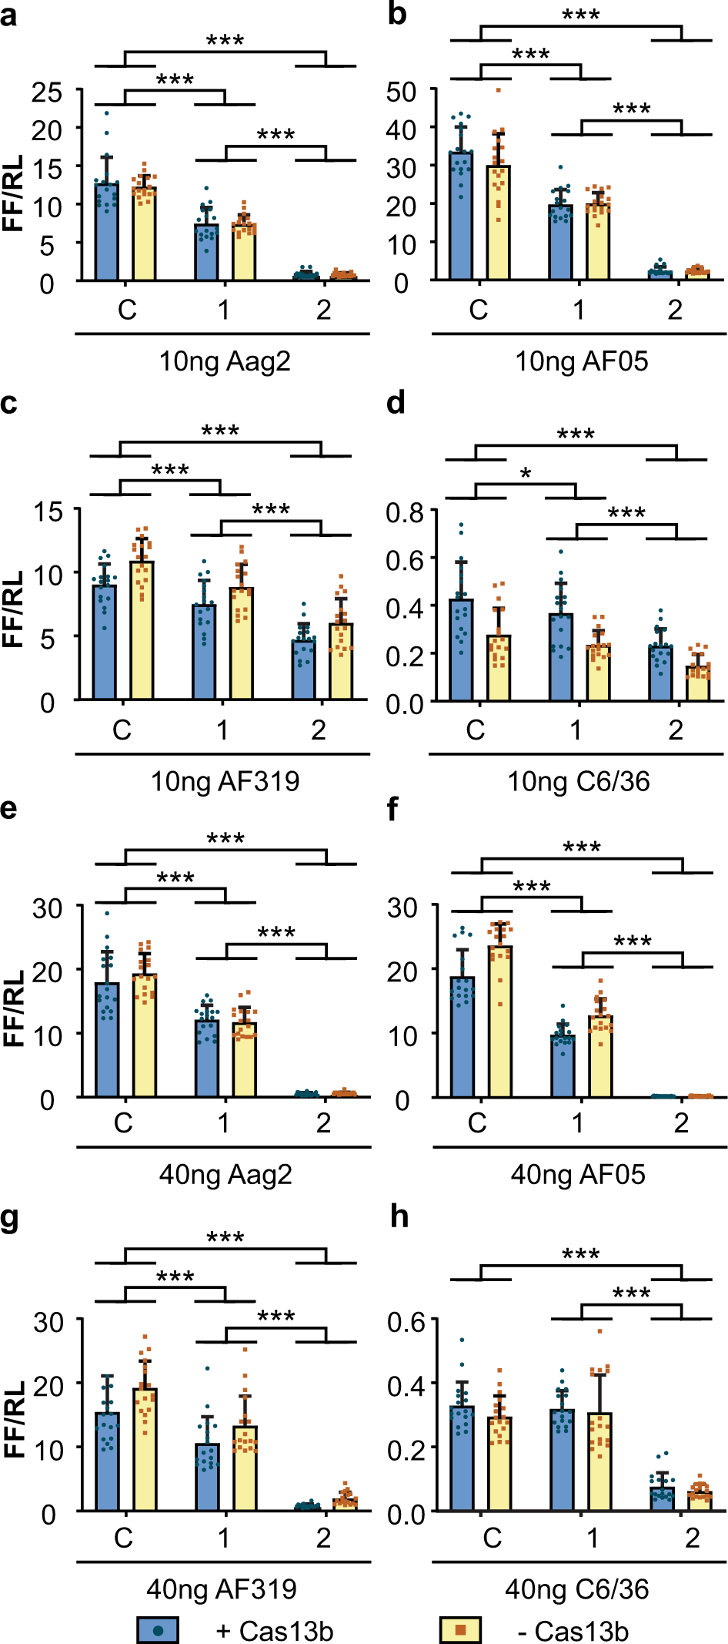
Unexpected Cas13-independent Knockdown
Guide-dependent knockdown in absence of Cas13 plasmid
C: non-targeting control guide
1: guide 1
2: guide 2
Tng et al, Communications Biology (Nature), 2020

Slide 12
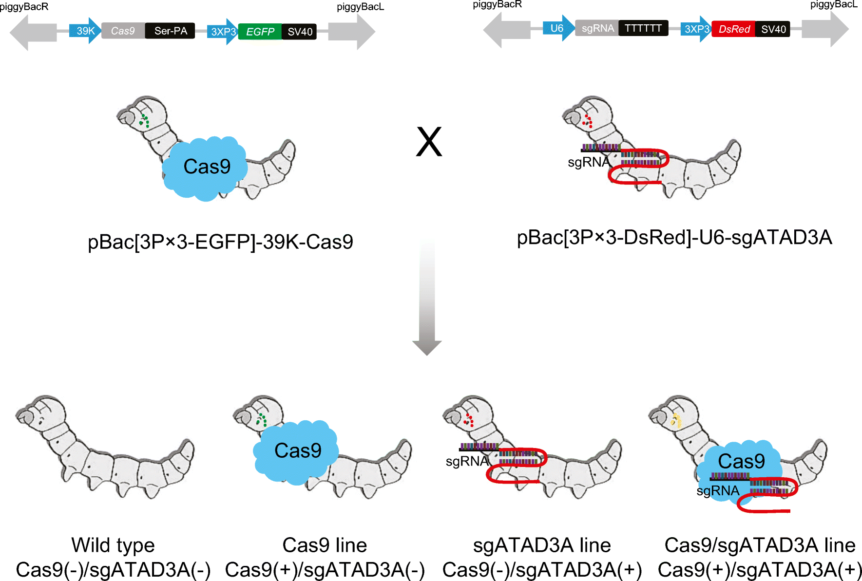
Virus-inducible CRISPR/Cas9 System
Dong et al, Applied Microbiology and Biotechnology, 2018

Slide 13
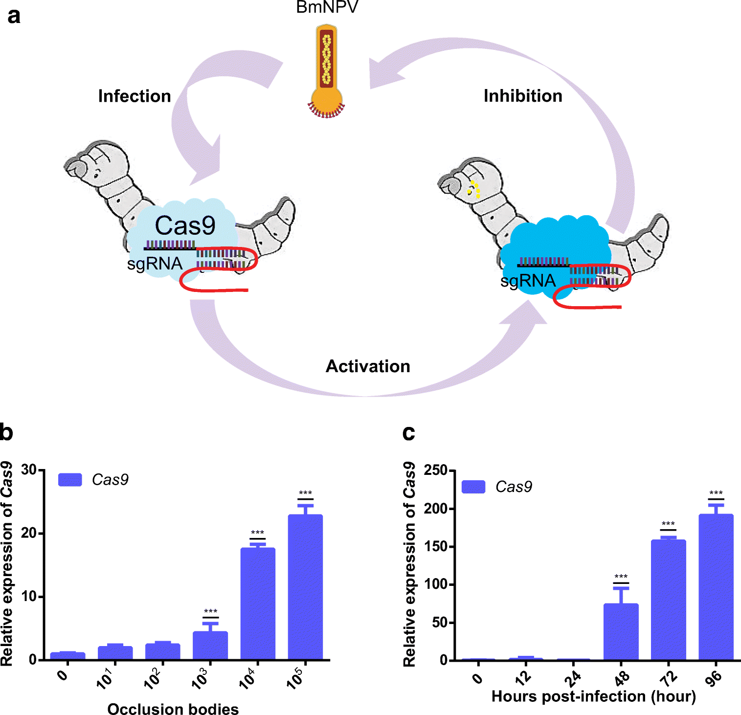
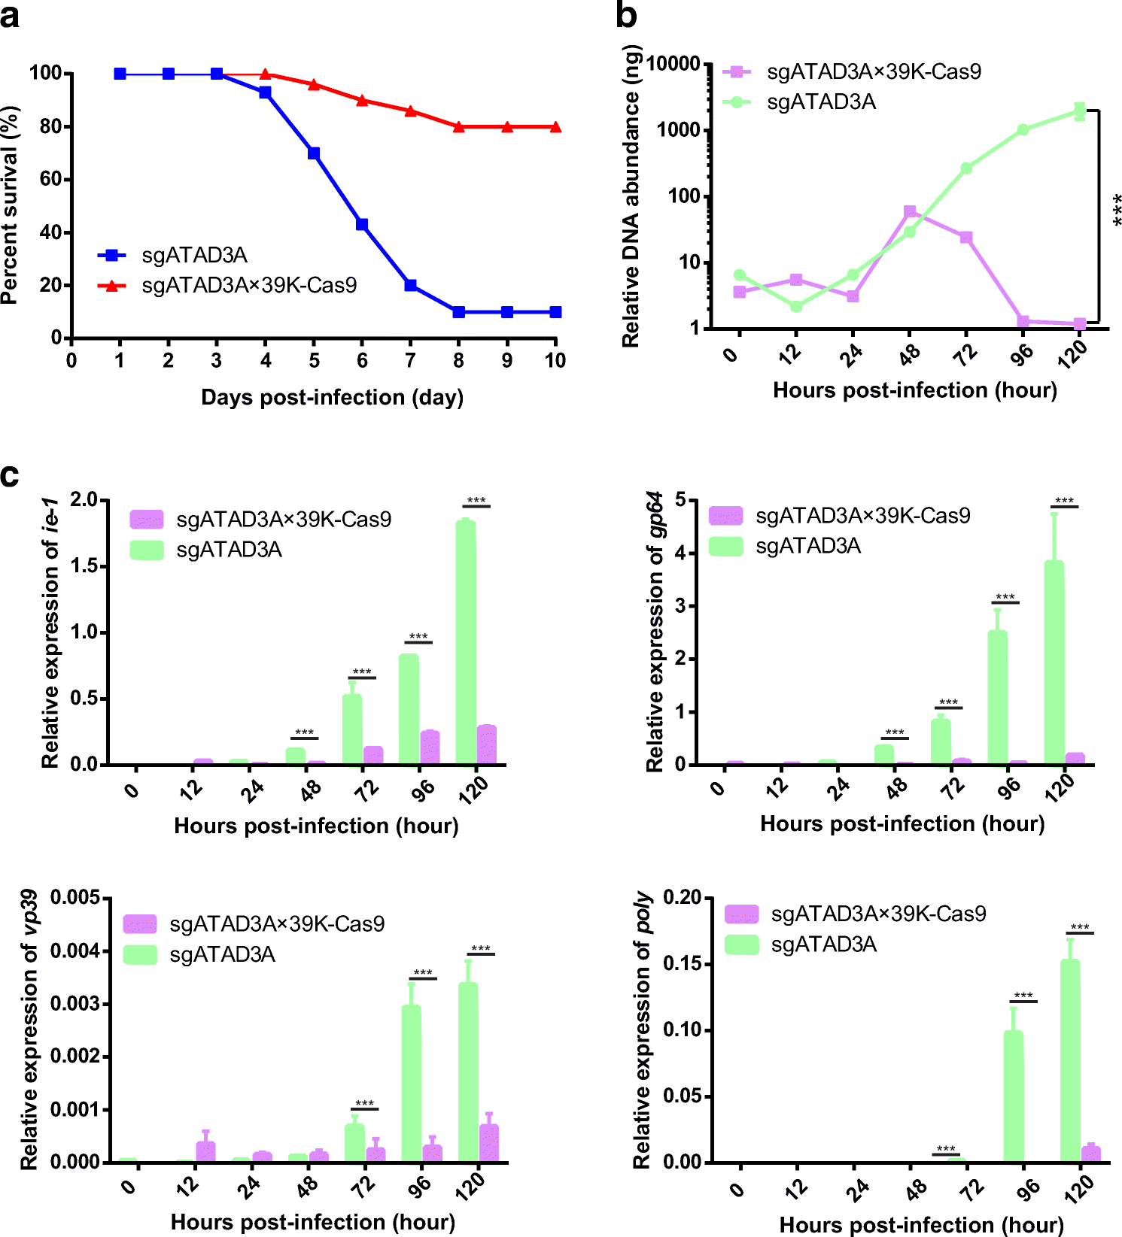
Dong et al, Applied Microbiology and Biotechnology, 2018

Slide 14
Conclusions and the Future
Flexible platform against emerging viruses
Metagenomics – uncultivated microbes (Xu et al, Nature Methods, May 2021)

